Slide 1
Worship Leader: ¹Therefore, since we have been justified by faith, we have peace with God through our Lord Jesus Christ.
ALL: ²Through him we have also obtained access by faith into this grace in which we stand, and we rejoice in hope of the glory of God.
11 I am the good shepherd. The good shepherd lays down his life for the sheep. 12 He who is a hired hand and not a shepherd, who does not own the sheep, sees the wolf coming and leaves the sheep and flees, and the wolf snatches them and scatters them. 13 He flees because he is a hired hand and cares nothing for the sheep.

Slide 2
WL: ³Not only that, but we rejoice in our sufferings, knowing that suffering produces endurance, ⁴and endurance produces character, and character produces hope,
ALL: ⁵and hope does not put us to shame, because God's love has been poured into our hearts through the Holy Spirit who has been given to us.
Romans 5:1-5
11 I am the good shepherd. The good shepherd lays down his life for the sheep. 12 He who is a hired hand and not a shepherd, who does not own the sheep, sees the wolf coming and leaves the sheep and flees, and the wolf snatches them and scatters them. 13 He flees because he is a hired hand and cares nothing for the sheep.

Slide 3
WL: In Christ, let us stand the light of God’s grace this morning to be renewed in the love he has poured into our hearts through the Holy Spirit.
ALL: Let us rejoice in the hope of the glory of God!
11 I am the good shepherd. The good shepherd lays down his life for the sheep. 12 He who is a hired hand and not a shepherd, who does not own the sheep, sees the wolf coming and leaves the sheep and flees, and the wolf snatches them and scatters them. 13 He flees because he is a hired hand and cares nothing for the sheep.

Slide 5
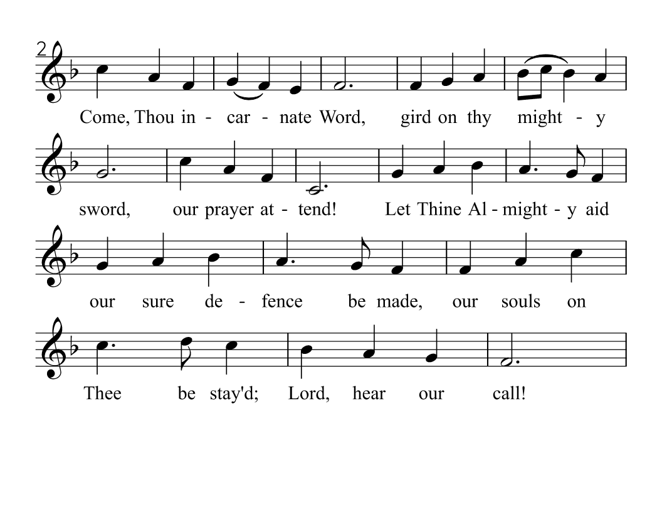

Slide 6
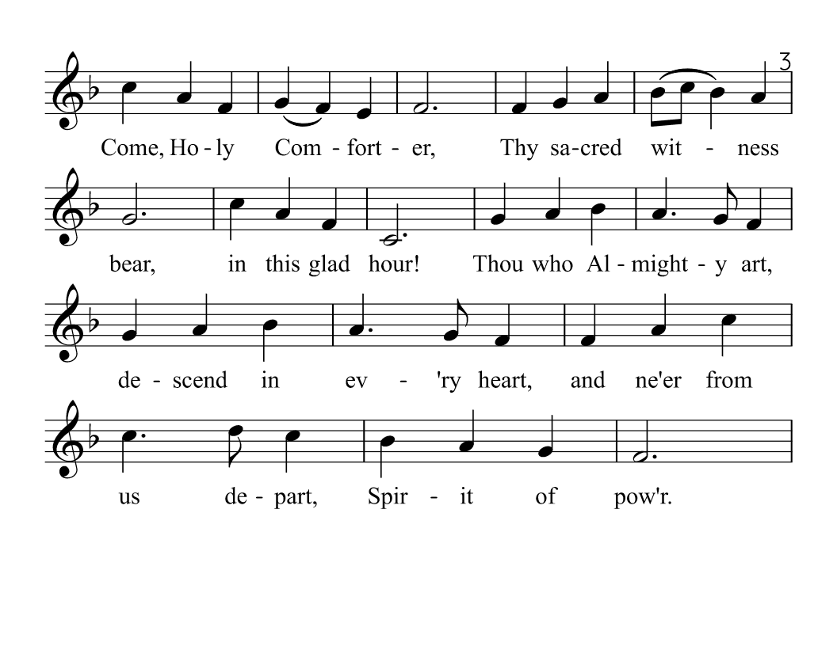

Slide 7
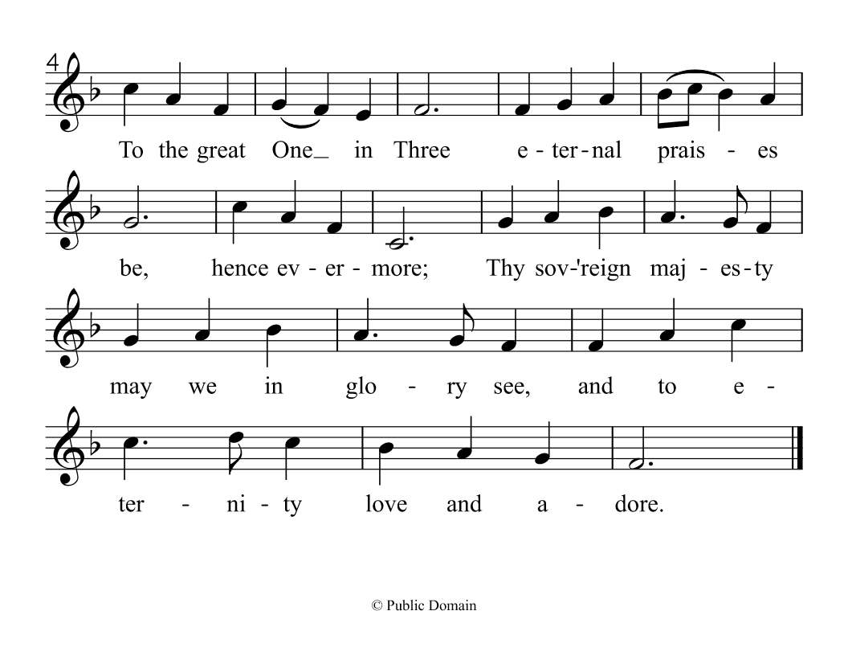

Slide 8
Generous God, you send us the Spirit of courage, but we have been afraid. You send us the Spirit of truth, but we cling to our illusions. You send us the Spirit of healing, but we cannot let go of our hurts. Holy Spirit of forgiveness, come to us again: shake our hearts, set our souls on fire with your love: send us out rejoicing in your power.
11 I am the good shepherd. The good shepherd lays down his life for the sheep. 12 He who is a hired hand and not a shepherd, who does not own the sheep, sees the wolf coming and leaves the sheep and flees, and the wolf snatches them and scatters them. 13 He flees because he is a hired hand and cares nothing for the sheep.

Slide 9
We hold out to you all our particular burdens of guilt and sin, and we ask for your help to live the way of your justice and love. Amen.
(Worship SourceBook Q.2.2.5 on p. 703)
11 I am the good shepherd. The good shepherd lays down his life for the sheep. 12 He who is a hired hand and not a shepherd, who does not own the sheep, sees the wolf coming and leaves the sheep and flees, and the wolf snatches them and scatters them. 13 He flees because he is a hired hand and cares nothing for the sheep.

Slide 10
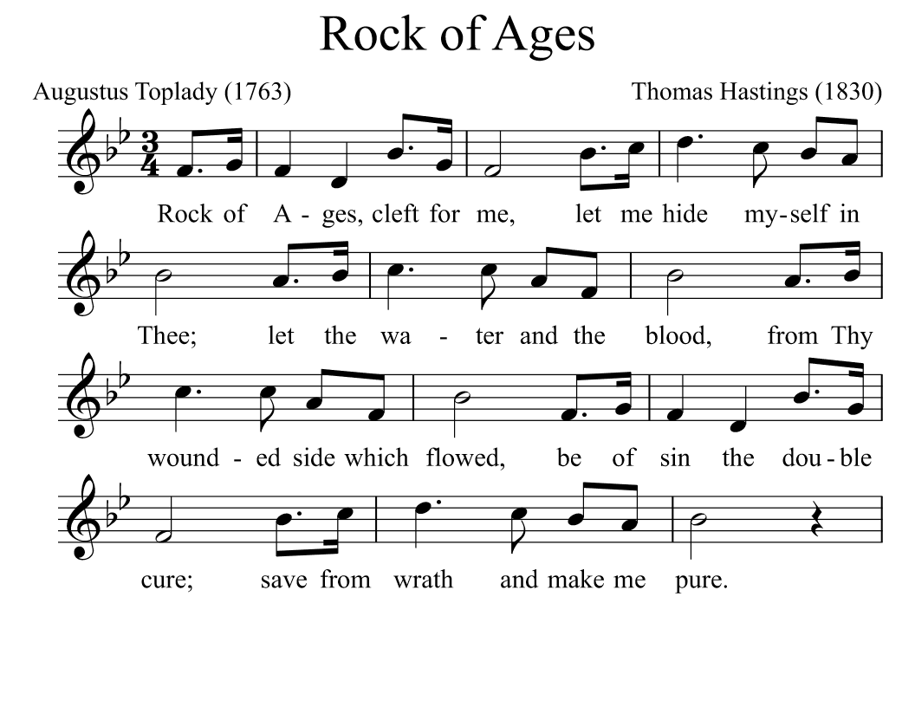

Slide 11
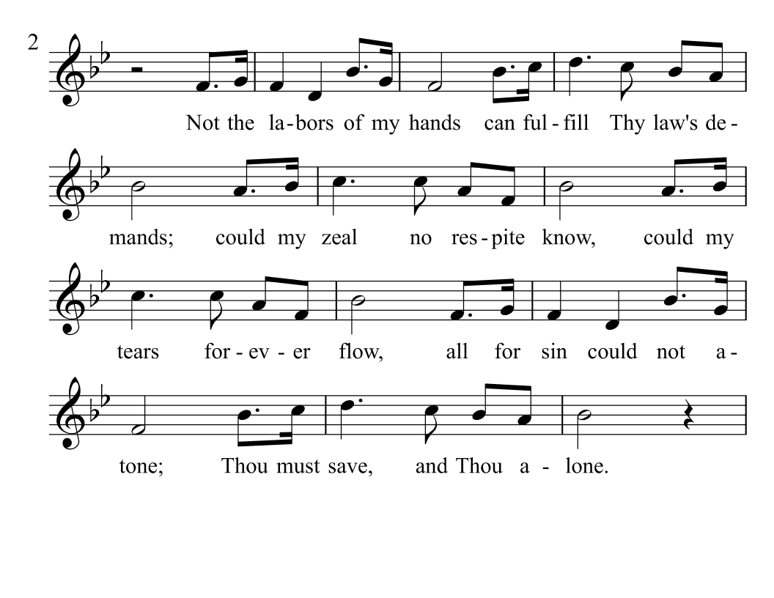

Slide 12
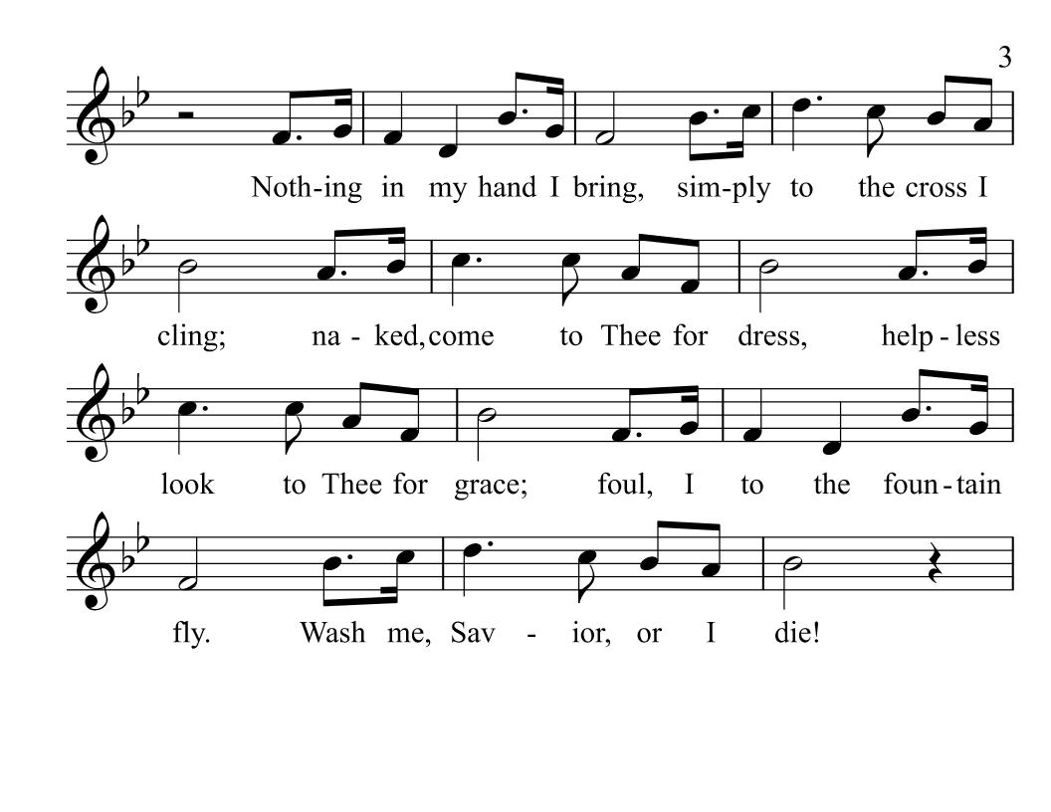

Slide 13
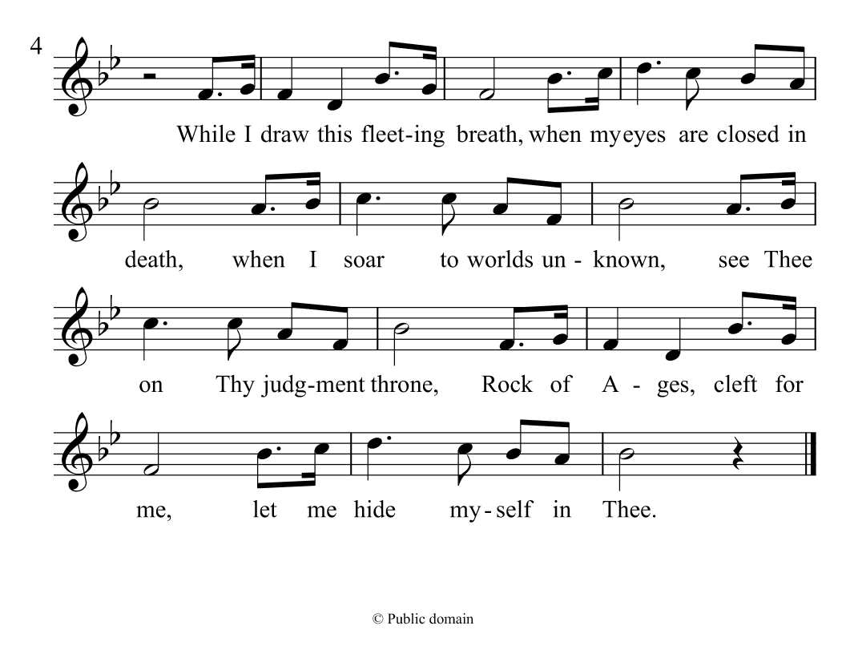

Slide 16
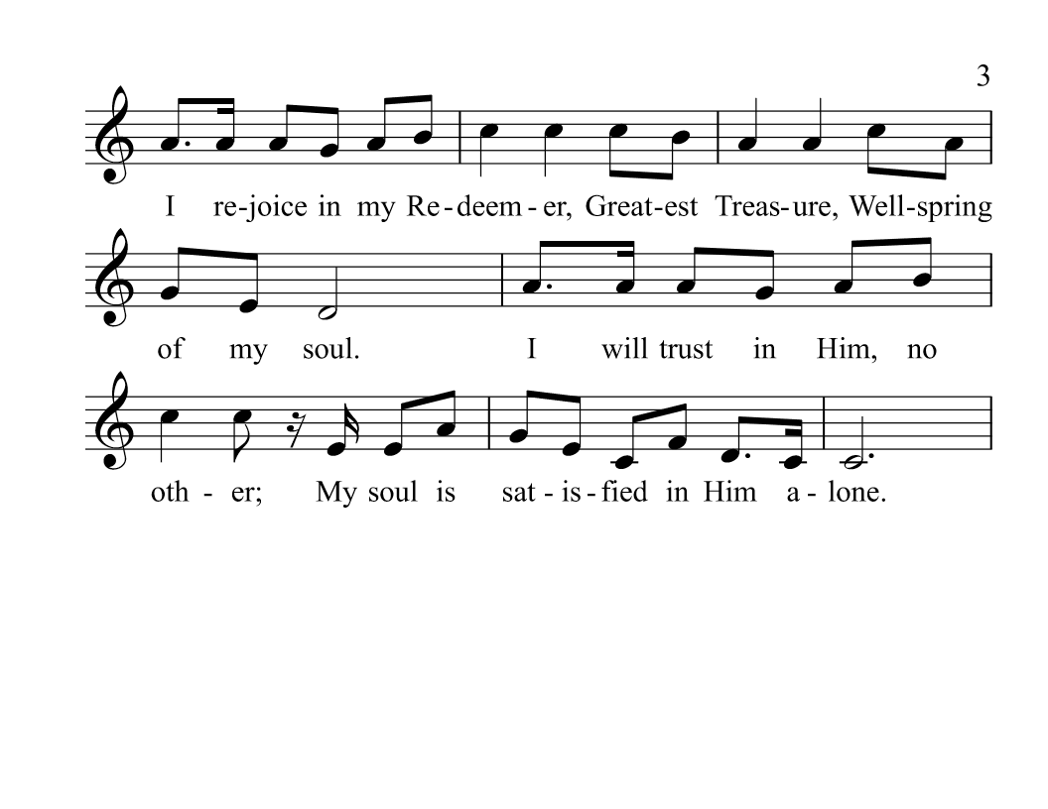

Slide 19
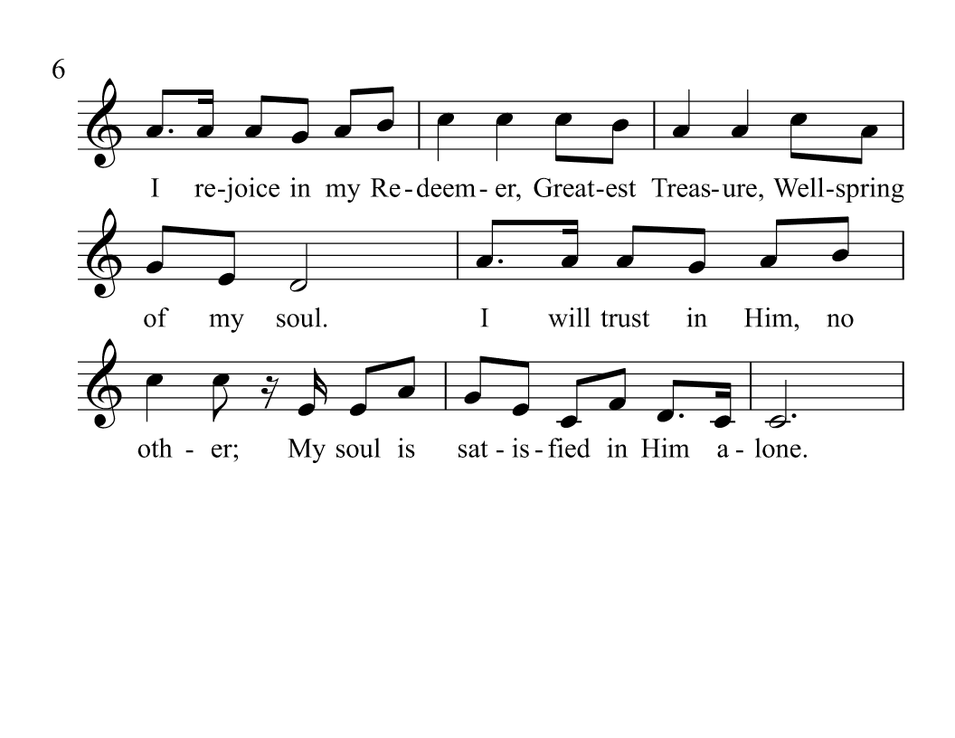

Slide 20
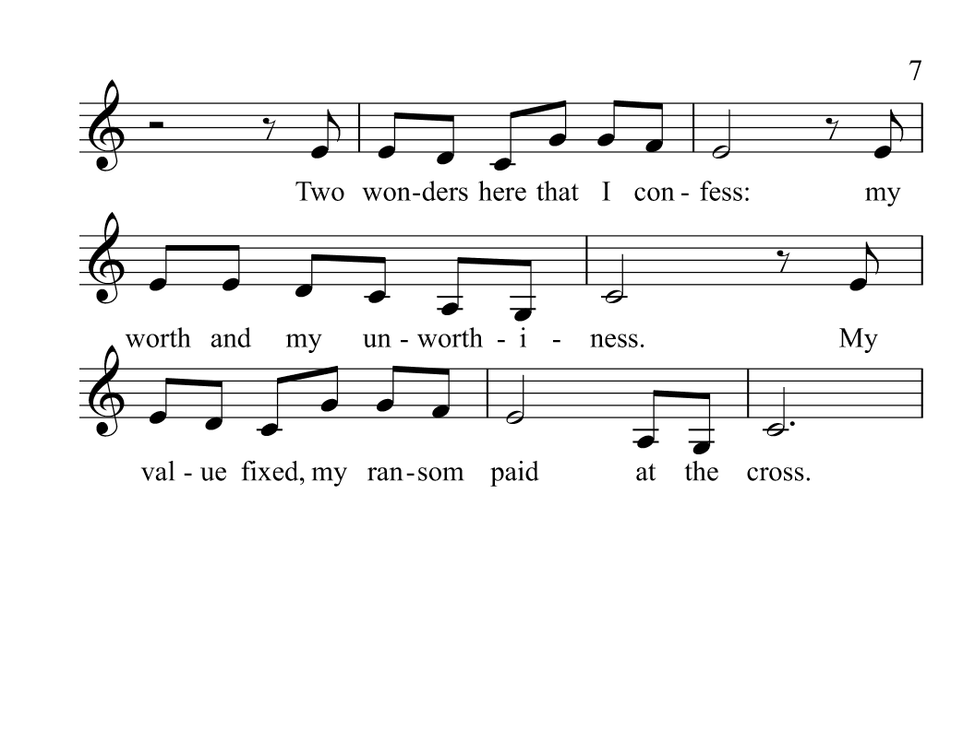

Slide 21
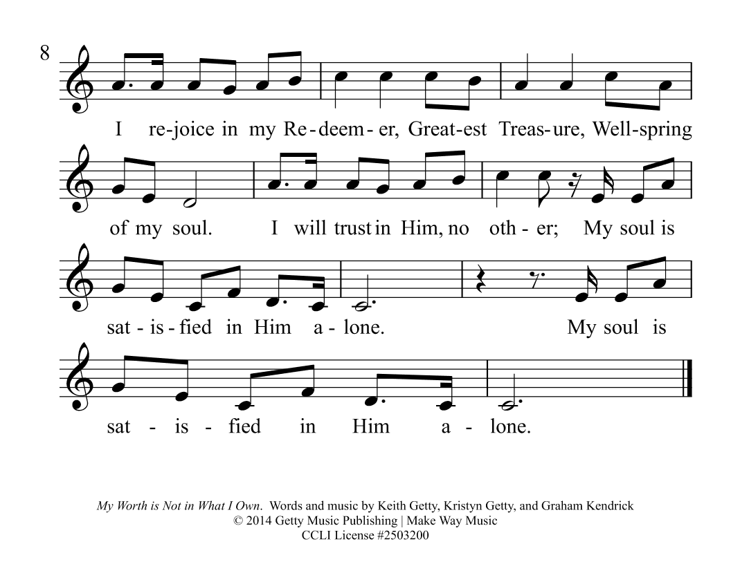

Slide 22
Our Father who art in heaven, hallowed be thy name. Thy kingdom come, thy will be done on earth as it is in heaven. Give us this day our daily bread. And forgive us our debts, as we forgive our debtors. And lead us not into temptation, but deliver us from evil. For thine is the kingdom, and the power, and the glory forever. Amen
11 I am the good shepherd. The good shepherd lays down his life for the sheep. 12 He who is a hired hand and not a shepherd, who does not own the sheep, sees the wolf coming and leaves the sheep and flees, and the wolf snatches them and scatters them. 13 He flees because he is a hired hand and cares nothing for the sheep.

Slide 23
¹And Saul approved of his execution. And there arose on that day a great persecution against the church in Jerusalem, and they were all scattered throughout the regions of Judea and Samaria, except the apostles. ²Devout men buried Stephen and made great lamentation over him.
11 I am the good shepherd. The good shepherd lays down his life for the sheep. 12 He who is a hired hand and not a shepherd, who does not own the sheep, sees the wolf coming and leaves the sheep and flees, and the wolf snatches them and scatters them. 13 He flees because he is a hired hand and cares nothing for the sheep.

Slide 24
³But Saul was ravaging the church, and entering house after house, he dragged off men and women and committed them to prison. ⁴Now those who were scattered went about preaching the word.
Acts 8:1-4 ESV
11 I am the good shepherd. The good shepherd lays down his life for the sheep. 12 He who is a hired hand and not a shepherd, who does not own the sheep, sees the wolf coming and leaves the sheep and flees, and the wolf snatches them and scatters them. 13 He flees because he is a hired hand and cares nothing for the sheep.

Slide 25
Acts 8:1 ESV
¹And Saul approved of his execution. And there arose on that day a great persecution against the church in Jerusalem, and they were all scattered throughout the regions of Judea and Samaria, except the apostles.

Slide 26
Acts 8:2 ESV
²Devout men buried Stephen and made great lamentation over him.

Slide 27
Acts 8:3 ESV
³But Saul was ravaging the church, and entering house after house, he dragged off men and women and committed them to prison.

Slide 28
Acts 8:4 ESV
⁴Now those who were scattered went about preaching the word.

Slide 29
Acts 8:5 ESV
⁵Philip went down to the city of Samaria and proclaimed to them the Christ.

Slide 30
Acts 8:6 ESV
⁶And the crowds with one accord paid attention to what was being said by Philip, when they heard him and saw the signs that he did.

Slide 31
Acts 8:7 ESV
⁷For unclean spirits, crying out with a loud voice, came out of many who had them, and many who were paralyzed or lame were healed.

Slide 32
Acts 8:8 ESV
⁸So there was much joy in that city.

Slide 33
Acts 8:9 ESV
⁹But there was a man named Simon, who had previously practiced magic in the city and amazed the people of Samaria, saying that he himself was somebody great.

Slide 34
Acts 8:10 ESV
¹⁰They all paid attention to him, from the least to the greatest, saying, “This man is the power of God that is called Great.”

Slide 35
Acts 8:11 ESV
¹¹And they paid attention to him because for a long time he had amazed them with his magic.

Slide 36
Acts 8:12 ESV
¹²But when they believed Philip as he preached good news about the kingdom of God and the name of Jesus Christ, they were baptized, both men and women.

Slide 37
Acts 8:13 ESV
¹³Even Simon himself believed, and after being baptized he continued with Philip. And seeing signs and great miracles performed, he was amazed.

Slide 38
Acts 8:14 ESV
¹⁴Now when the apostles at Jerusalem heard that Samaria had received the word of God, they sent to them Peter and John,

Slide 39
Acts 8:15 ESV
¹⁵who came down and prayed for them that they might receive the Holy Spirit,

Slide 40
Acts 8:16 ESV
¹⁶for he had not yet fallen on any of them, but they had only been baptized in the name of the Lord Jesus.

Slide 41
Acts 8:17 ESV
¹⁷Then they laid their hands on them and they received the Holy Spirit.

Slide 42
Acts 8:18 ESV
¹⁸Now when Simon saw that the Spirit was given through the laying on of the apostles' hands, he offered them money,

Slide 43
Acts 8:19 ESV
¹⁹saying, “Give me this power also, so that anyone on whom I lay my hands may receive the Holy Spirit.”

Slide 44
Acts 8:20 ESV
²⁰But Peter said to him, “May your silver perish with you, because you thought you could obtain the gift of God with money!

Slide 45
Acts 8:21 ESV
²¹You have neither part nor lot in this matter, for your heart is not right before God.

Slide 46
Acts 8:22 ESV
²²Repent, therefore, of this wickedness of yours, and pray to the Lord that, if possible, the intent of your heart may be forgiven you.

Slide 47
Acts 8:23 ESV
²³For I see that you are in the gall of bitterness and in the bond of iniquity.”

Slide 48
Acts 8:24 ESV
²⁴And Simon answered, “Pray for me to the Lord, that nothing of what you have said may come upon me.”

Slide 49
Acts 8:25 ESV
²⁵Now when they had testified and spoken the word of the Lord, they returned to Jerusalem, preaching the gospel to many villages of the Samaritans.

Slide 52
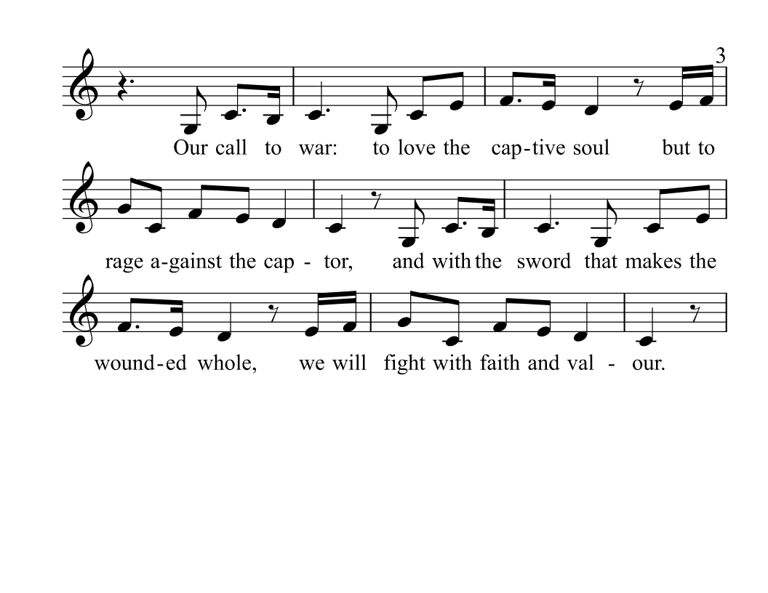

Slide 55
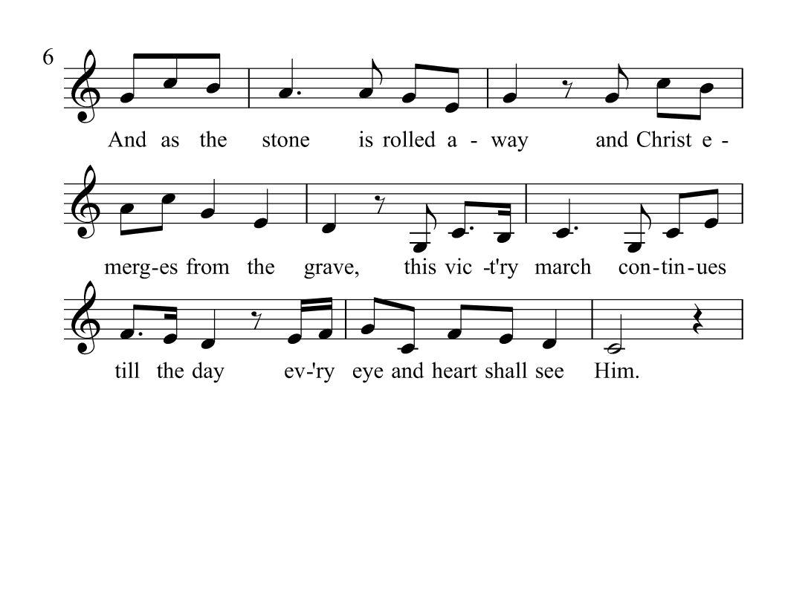

Slide 56
