Slide 4
Ephesians 2:11 ESV
Therefore remember that at one time you Gentiles in the flesh, called “the uncircumcision” by what is called the circumcision, which is made in the flesh by hands—

Slide 5
Ephesians 2:12 ESV
remember that you were at that time separated from Christ, alienated from the commonwealth of Israel and strangers to the covenants of promise, having no hope and without God in the world.

Slide 6
Ephesians 2:13 ESV
But now in Christ Jesus you who once were far off have been brought near by the blood of Christ.

Slide 7
Ephesians 2:14 ESV
For he himself is our peace, who has made us both one and has broken down in his flesh the dividing wall of hostility

Slide 8
Ephesians 2:15 ESV
by abolishing the law of commandments expressed in ordinances, that he might create in himself one new man in place of the two, so making peace,

Slide 9
Ephesians 2:16 ESV
and might reconcile us both to God in one body through the cross, thereby killing the hostility.

Slide 10
Ephesians 2:17-18 ESV
And he came and preached peace to you who were far off and peace to those who were near. For through him we both have access in one Spirit to the Father.

Slide 16
Forgiving Father, We do indeed have a glory problem. We so often live to glorify ourselves rather than to glorify you. We are too often selfish in our motives, actions, and deeds. We are too often focused on what we can get out of something rather than what we can give.

Slide 17
In our self-centeredness, we too often forget all that you have done for us, and thus fail to glorify your name. Forgive us Father. Help us to be more like Jesus in how we love, how we act, and how we glorify you. Amen.

Slide 20
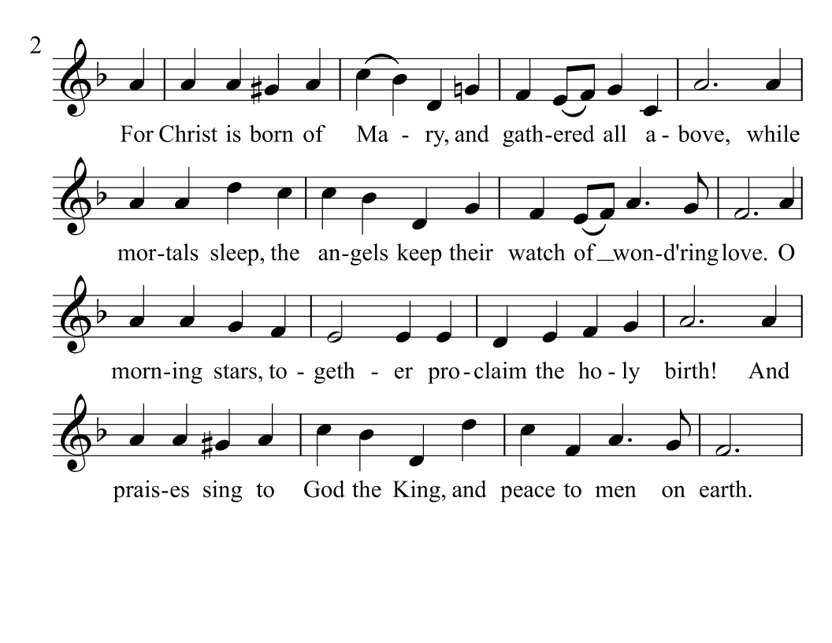

Slide 24
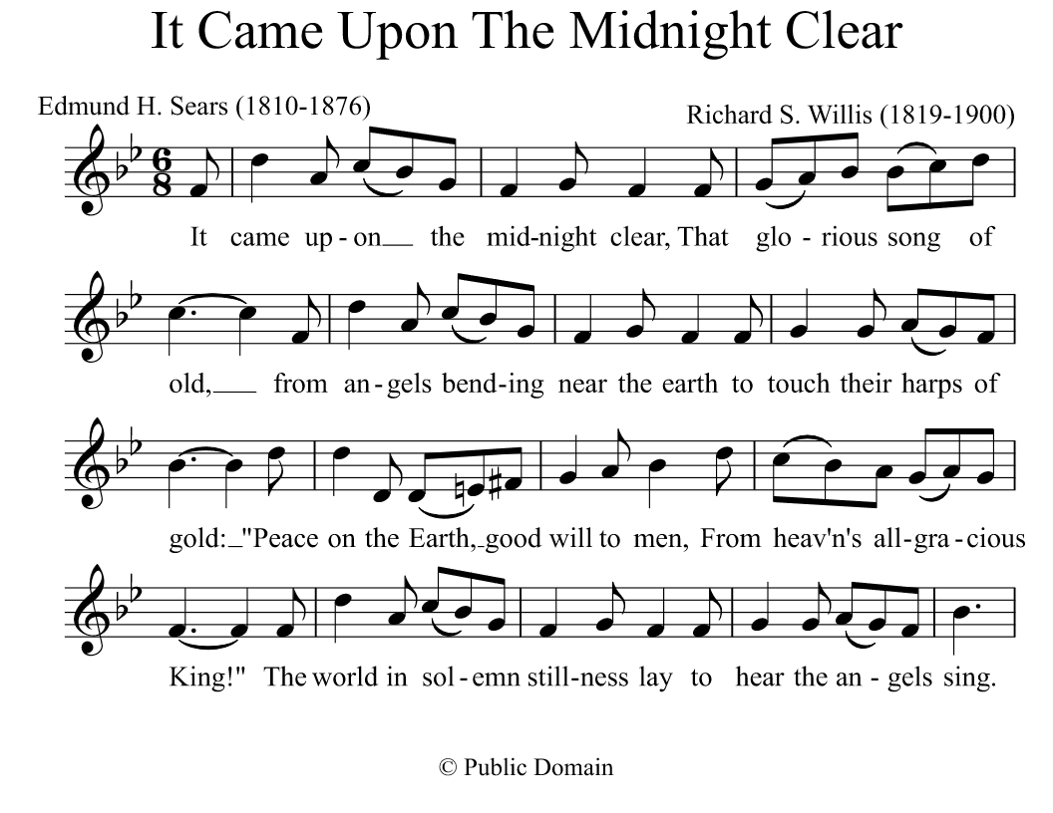

Slide 25
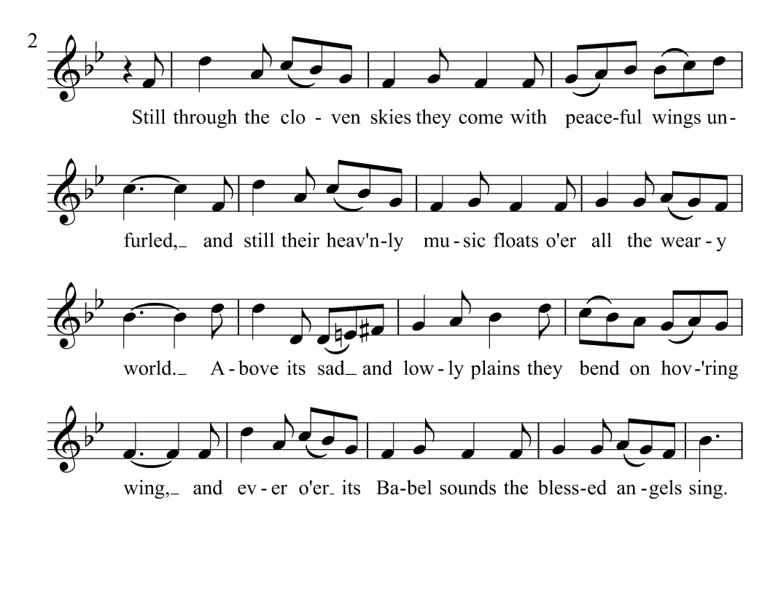

Slide 26
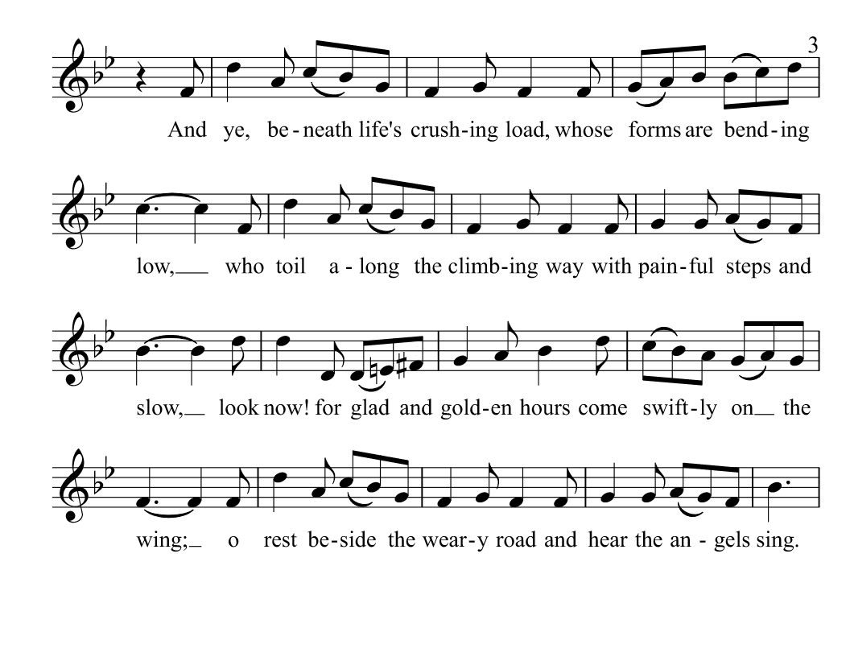

Slide 27
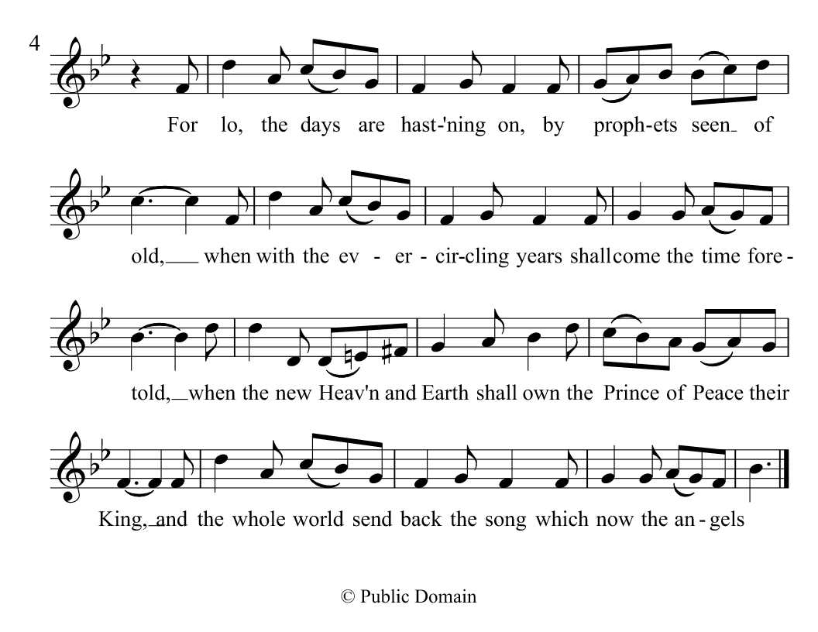

Slide 29
The Lord’s Prayer
Our Father who art in heaven, hallowed be Thy name. Thy kingdom come. Thy will be done on earth as it is in heaven. Give us this day our daily bread. And forgive us our debts as we forgive our debtors. And lead us not into temptation, but deliver us from evil, for Thine is the kingdom, and the power, and the glory forever. Amen.

Slide 33
Luke 2:8 ESV
And in the same region there were shepherds out in the field, keeping watch over their flock by night.

Slide 34
Luke 2:9 ESV
And an angel of the Lord appeared to them, and the glory of the Lord shone around them, and they were filled with great fear.

Slide 35
Luke 2:10 ESV
And the angel said to them, “Fear not, for behold, I bring you good news of great joy that will be for all the people.

Slide 36
Luke 2:11 ESV
For unto you is born this day in the city of David a Savior, who is Christ the Lord.

Slide 37
Luke 2:12 ESV
And this will be a sign for you: you will find a baby wrapped in swaddling cloths and lying in a manger.”

Slide 38
Luke 2:13 ESV
And suddenly there was with the angel a multitude of the heavenly host praising God and saying,

Slide 39
Luke 2:14 ESV
“Glory to God in the highest,
and on earth peace among those with whom he is pleased!”

Slide 41
Luke 2:8 ESV
And in the same region there were shepherds out in the field, keeping watch over their flock by night.

Slide 42
Luke 2:9 ESV
And an angel of the Lord appeared to them, and the glory of the Lord shone around them, and they were filled with great fear.

Slide 43
Luke 2:10 ESV
And the angel said to them, “Fear not, for behold, I bring you good news of great joy that will be for all the people.

Slide 45
Luke 2:11 ESV
For unto you is born this day in the city of David a Savior, who is Christ the Lord.

Slide 46
Luke 2:12 ESV
And this will be a sign for you: you will find a baby wrapped in swaddling cloths and lying in a manger.”

Slide 48
Luke 2:13 ESV
And suddenly there was with the angel a multitude of the heavenly host praising God and saying,

Slide 49
Luke 2:14 ESV
“Glory to God in the highest,
and on earth peace among those with whom he is pleased!”

Slide 52
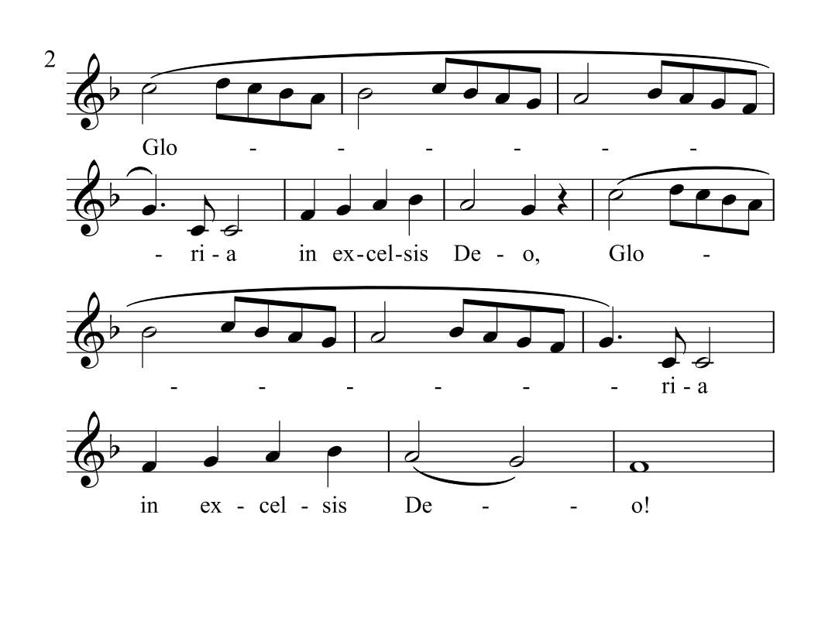

Slide 53
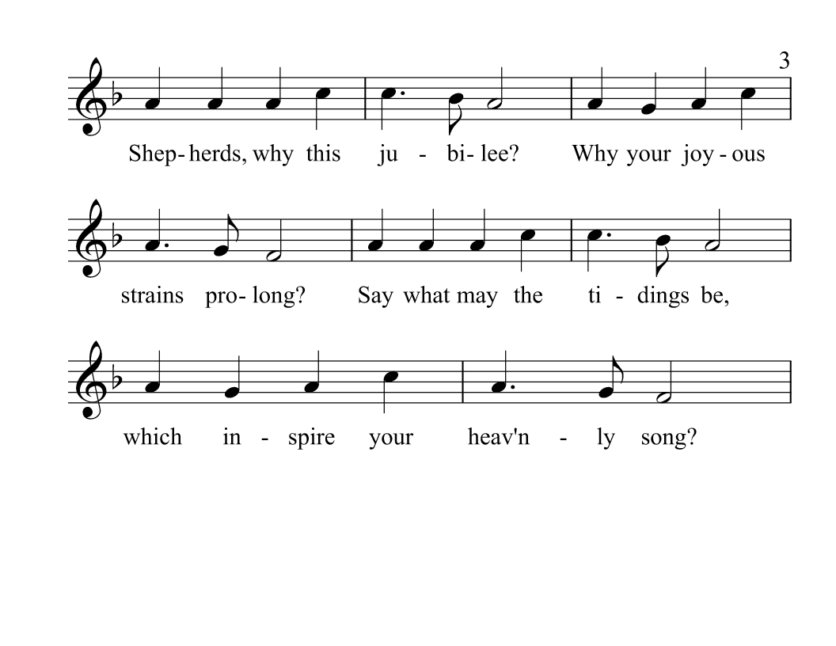

Slide 54
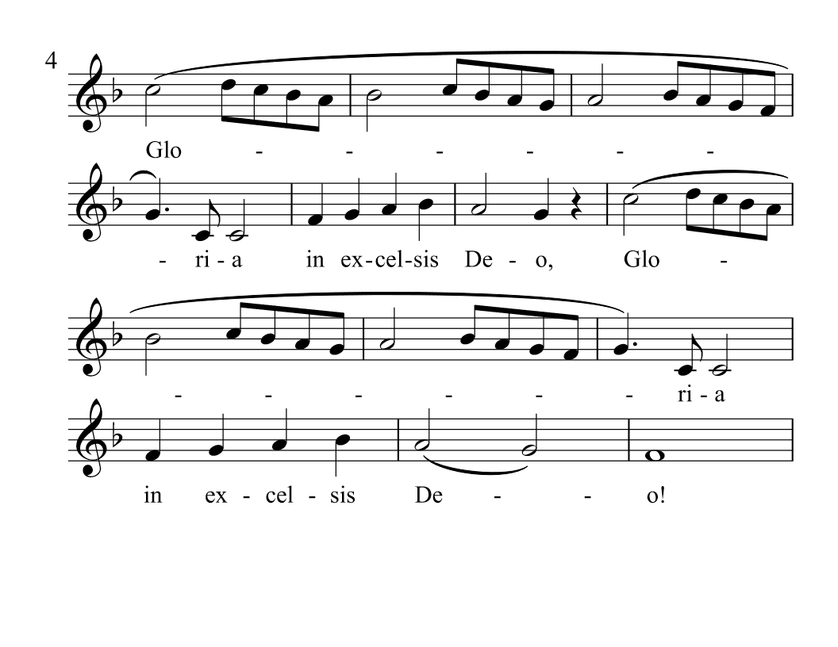

Slide 56
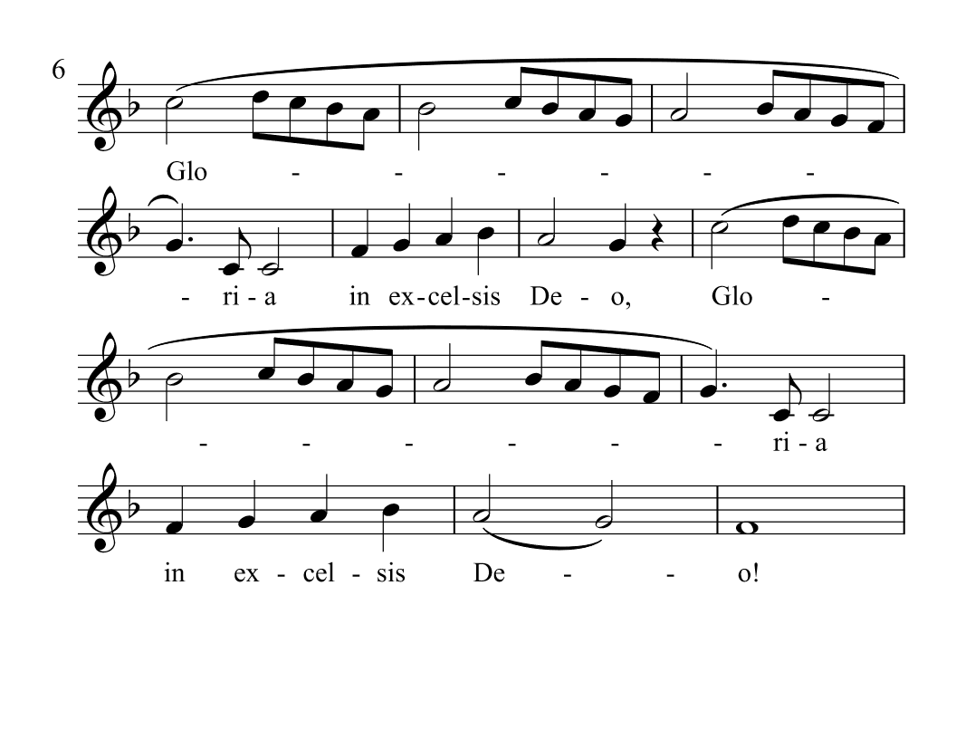

Slide 57
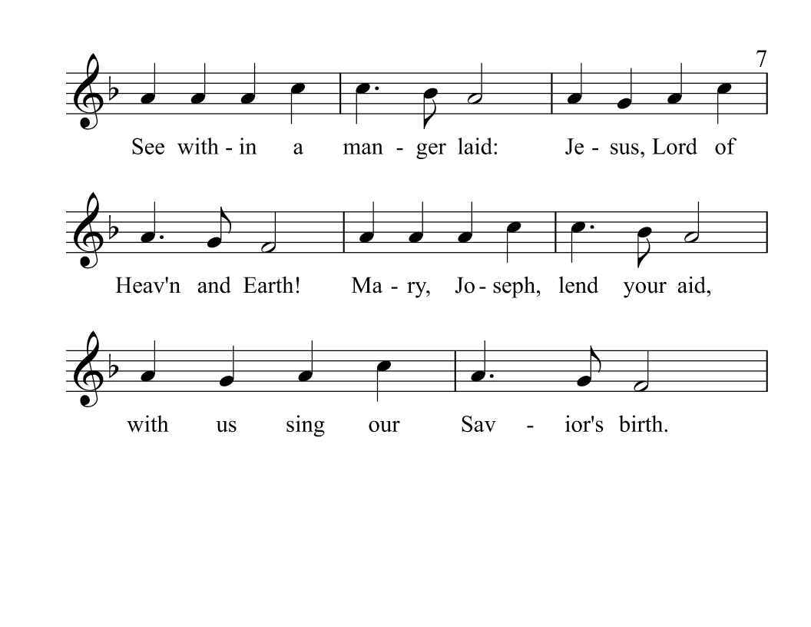

Slide 58
